Slide 1
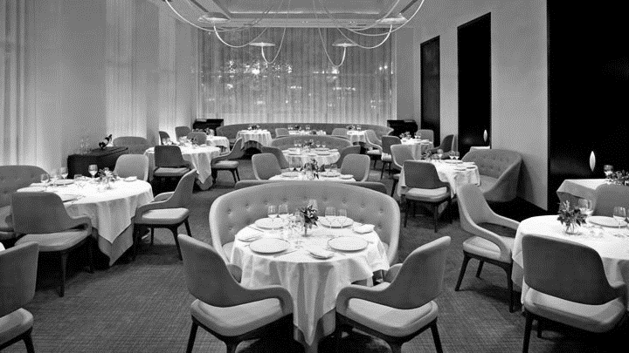
CASE STUDY - RESTAURANT
-- RAJASHREE UNNITHAN -- -- PRASHANT BHATT -- -- ROHAN CHIKORDE -- -- SWATI HEDAU --
SP JAIN SCHOOL OF GLOBAL MANAGEMENT

Slide 2
Case-study & Assumptions
Your client is a leading restaurant chain in the Indian market and feels there is scope to improve it’s profits. Being a leading organization in the sector, investment is not a big issue. It has been advised to the organization to open up new restaurants but the firm feels it has exhausted all the areas where it could grow. Acquiring new land is out of options.
You have been asked to give efficient recommendations and strategy the organization should follow to increase their profits. It wants to see the effect within a year of implementation of recommended strategies
It is a full service fine dine restaurant with platform bar.
It serves gourmet meals.
It has a basic non-interactive website.
Before providing a suggestion assumptions were made that the restaurant is currently not focusing in that area.

Slide 3

INDUSTRY ANALYSIS
The current size of the Indian food service industry is INR 247,680 crore and is projected to grow to INR 408,040 crore by 2018 at 11%.
INR 408,040 Crore
2018
In terms of market segments, Quick Service Restaurants (QSR) and Casual Dine-in formats account for 74% of the total chain market, while Cafés make up for 12% with Fine Dining and Pub Bars Club & Lounges (PBCL) comprising the rest.
The chain and licensed standalone industry is projected to contribute more than double to INR 24,600-25,000 crore by 2018.
CURRENT
INR 247,680 Crore
* Data based on NRAI’s India Food Services Report 2013

Slide 4
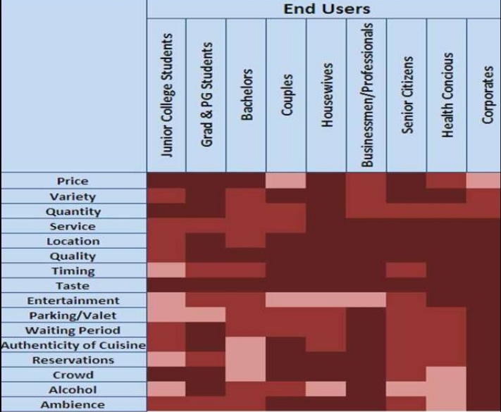
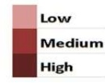
FULL SERVICE RESTAURANTS
*Data taken from Linked In

Slide 5
PROBLEM STATEMENT WORKSHEET
How can XYZ restaurant increase its profitability from x % to y % within a year?
1. Background
4. Constraints
The client XYZ is a leading full service restaurant chain in the Indian market.
It is experiencing a stagnation in profit margins.
The chain has invested significantly into properties and is now positioned in most of the commercial complexes and wants to increase the revenue from current level of x% to at least y%.
Client is happy with the restaurant traffic but concerned about the weak waiting time management.
Focus is to boost overall profit of the client within a year.
Government policies.
Inorganic growth ruled out due to time constraints.
5. Stakeholders
Investors.
Marketing Team.
Waiter.
Chefs.
End-User.
2. Desired Outcomes
Increase in profitability from x% to y%.
Improvement in overall service quality.
6. Resources
3. Scope
Information gathered through research.
Minimal IT infrastructure.
Team of 4 strategists.
Target Indian market.
New Acquisition is out of scope.

Slide 6
ISSUE TREE
Increase in number of customers
A1
Increase in Revenue
Increase in average transaction size
How can XYZ restaurant increase its profitability from X% to Y% within a year?
Increase in frequency of transaction per customer
Decrease in Cost

Slide 7
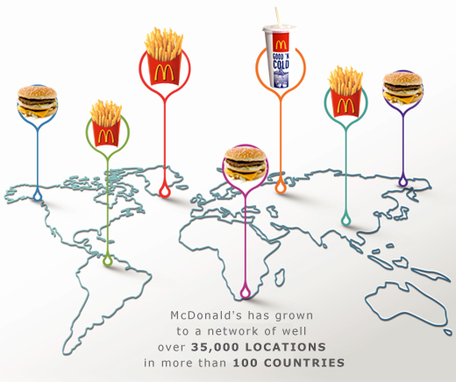
ISSUE TREE
Customer Referral
Giving out Franchise
Digital
Offer free Wi-Fi
A1
Social Media Marketing
Marketing
Sponsorship
Offline
Merchandising

Slide 8
ISSUE TREE
Increase in number of customers
A1
Increase in Revenue
Increase in average transaction size
A2
How can XYZ restaurant increase its profitability from 30% to 34% within a year?
Increase in frequency of transaction per customer
Decrease in Cost

Slide 9
ISSUE TREE
Apply dynamic pricing
Re-engineering the menu
Design your menu smartly.
A2
Offering Combo Deals
Upselling Customers

Slide 10
ISSUE TREE
Increase in number of customers
A1
Increase in Revenue
Increase in average transaction size
A2
How can XYZ restaurant increase its profitability from 30% to 34% within a year?
Increase in frequency of transaction per customer
A3
Decrease in Cost

Slide 11
ISSUE TREE
E-menu
Rewards through Loyalty Program
Use of Technology
Both text and audio feedback
A3
Promptly attending to customer’s feedback
Train your staff
Improving the service
Change in Management practices
Rewarding the staff

Slide 12
ISSUE TREE
Increase in number of customers
A1
Increase in Revenue
Increase in average transaction size
A2
How can XYZ restaurant increase its profitability from 30% to 34% within a year?
Increase in frequency of transaction per customer
A3
Decrease in Cost
B

Slide 13
ISSUE TREE
Track Inventory
Decrease waste
Increase customer awareness
B
Farm to table
Implement technological solutions
Go paperless on bills

Slide 14
Bibliography
National Restaurant Association of India Report on restaurant
http://nrai.org/
Full service restaurant – heat map
http://www.slideshare.net/businessdesign2011/restaurants-13707753
Franchisee suggestion backed by:
http://www.franchisedirect.com/information/markettrendsfactsaboutfranchising/thesuccessofmcdonalds/8/1111/
Farm to table implementation in India:
http://www.luxpresso.com/photogallery-lifestyle/luxury-food-farm-to-table-dining-in-india/15042887
http://www.franchiseindia.com/magazine/2015/February/Finest-returns-in-casual-fine-dine-biz.1297

Slide 15
Thank You
ANY QUESTIONS?

